Slide 1
Linear Mapping Kernel and Image space of a linear map Matrix associated with linear map

Slide 2
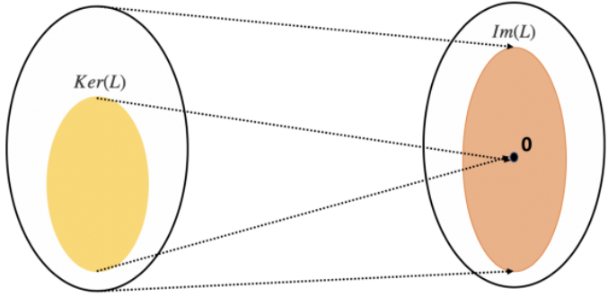
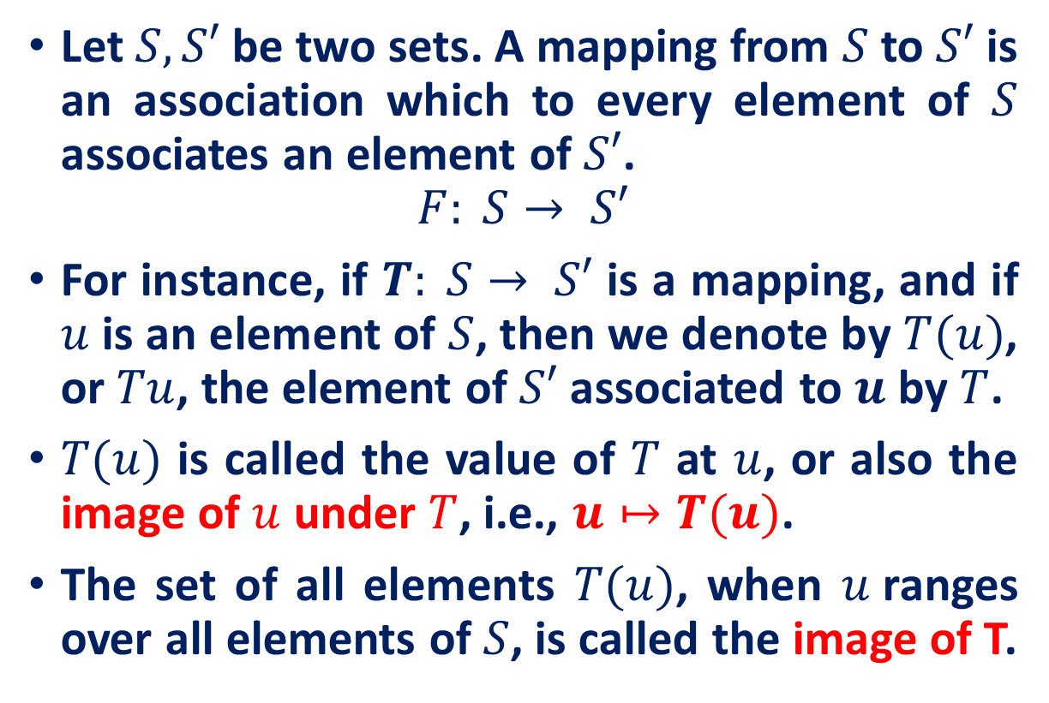
Mappings
Let $S, S′$be two sets. A mapping from $S$ to $S′$ is an association which to every element of $S$ associates an element of $S′$.
$$F: S→ S′$$
For instance, if $T: S→ S′$ is a mapping, and if $u$ is an element of $S$, then we denote by $T(u)$, or $Tu$, the element of $S′$associated to $u$ by $T$.
$T(u)$ is called the value of $T$ at $u$, or also the image of $u$ under $T$, i.e., $u↦T(u)$.
The set of all elements $T(u)$, when $u$ranges over all elements of $S$, is called the image of T.

Slide 3
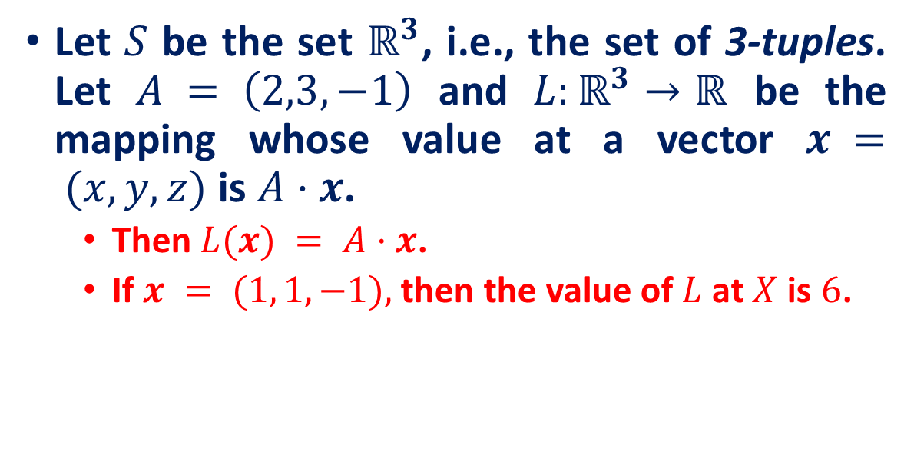

Mappings
For any set S we have the identity mapping $I: S→ S$. It is defined by $I(x) = x$for all x.
Let $S$ be the set $ℝ^{3}$, i.e., the set of 3-tuples. Let $A = \left(2,3, −1\right)$ and $L:ℝ^{3}→ℝ$ be the mapping whose value at a vector $x = (x,y,z)$is $A·x$.
Then $L(x) = A·x$.
If $x = (1, 1, −1),$then the value of $L$ at $X$ is $6$.

Slide 4
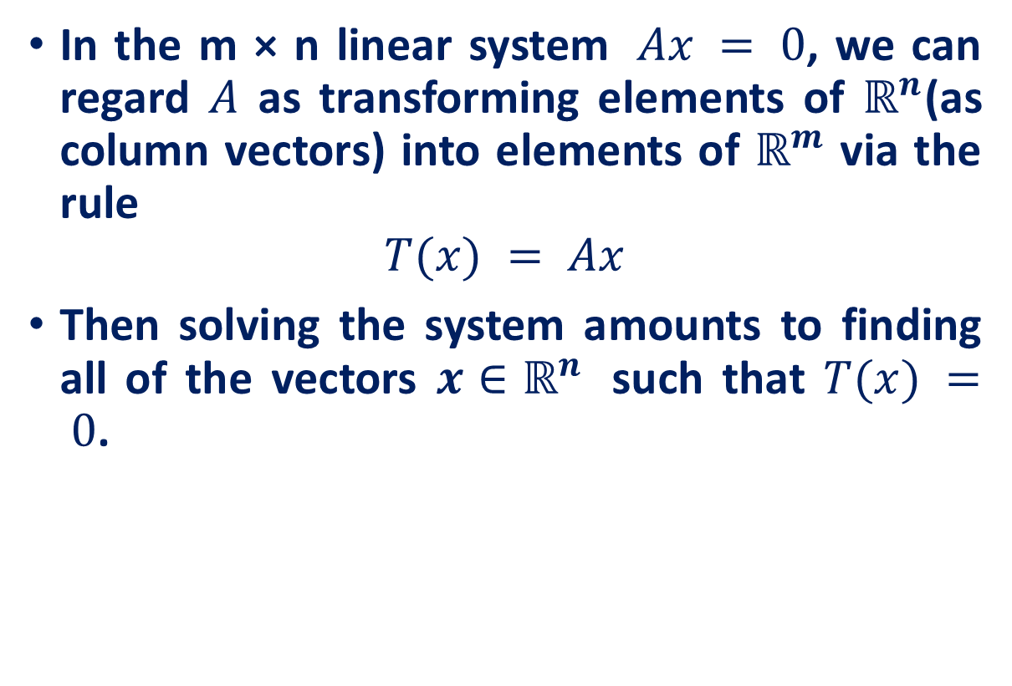
Mappings
In the m × n linear system $Ax = 0$, we can regard $A$ as transforming elements of $ℝ^{n}$(as column vectors) into elements of $ℝ^{m}$ via the rule
$$T(x) = Ax$$
Then solving the system amounts to finding all of the vectors ${x∈ℝ}^{n}$ such that $T(x) = 0$.

Slide 5
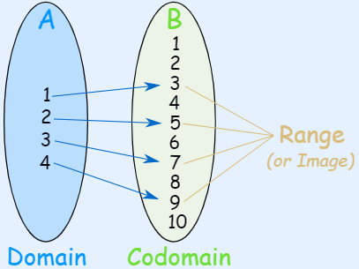
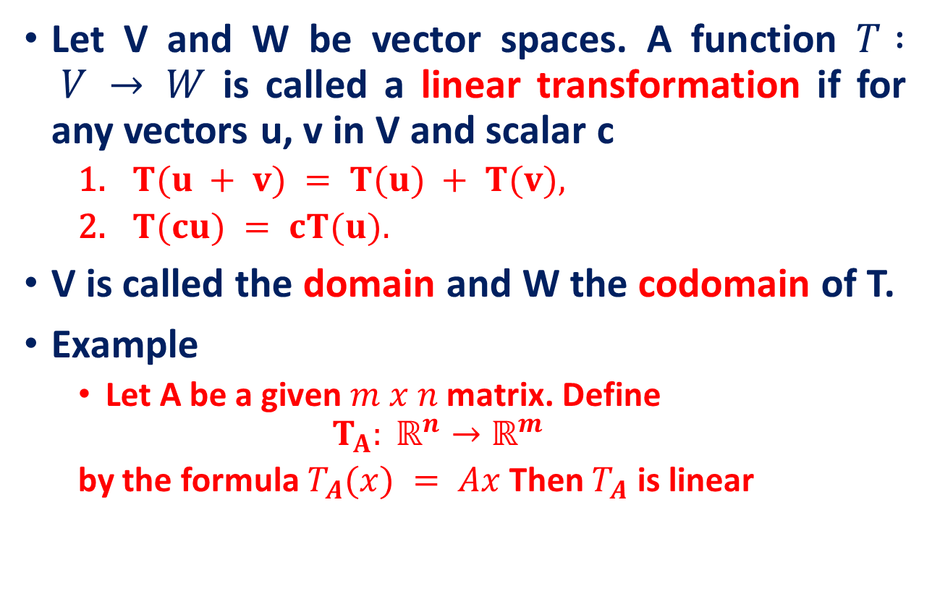

Linear Transformation
Let V and W be vector spaces. A function $T : V → W$ is called a linear transformation if for any vectors u, v in V and scalar c
$T(u + v) = T(u) + T(v),$
$T(cu) = cT(u).$
V is called the domain and W the codomain of T.
Example
Let A be a given $m x n$ matrix. Define
$$T_{A}: ℝ^{n}→ℝ^{m}$$
by the formula $T_{A}(x) = Ax$ Then $T_{A}$ is linear
$$T: x→2x+1$$
Image Source: https://www.mathsisfun.com/sets/domain-range-codomain.html

Slide 6
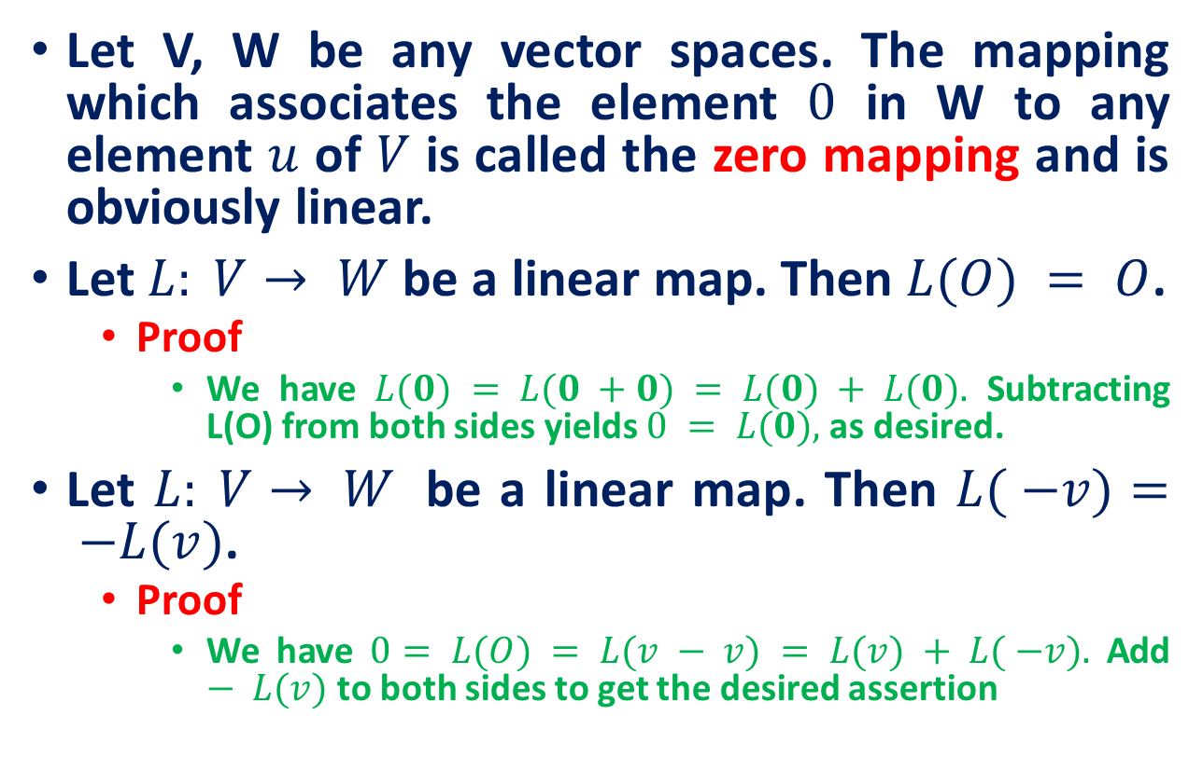
Linear Transformation
Let V, W be any vector spaces. The mapping which associates the element $0$ in W to any element $u$ of $V$ is called the zero mapping and is obviously linear.
Let $L: V→ W$be a linear map. Then $L(O) = O$.
Proof
We have $L(0) = L(0 +0) = L(0) + L(0).$ Subtracting L(O) from both sides yields $0 = L(0),$as desired.
Let $L: V→ W$ be a linear map. Then $L( −v)= −L(v)$.
Proof
We have $0= L(O) = L(v − v) = L(v) + L( −v).$ Add $− L(v)$to both sides to get the desired assertion

Slide 7
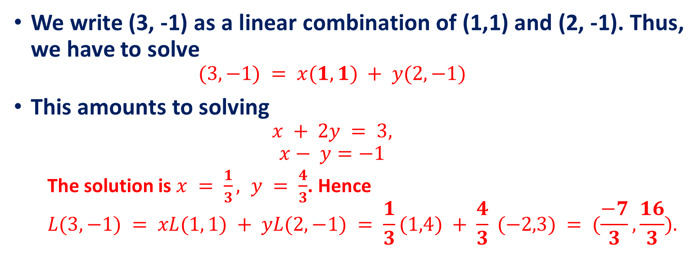
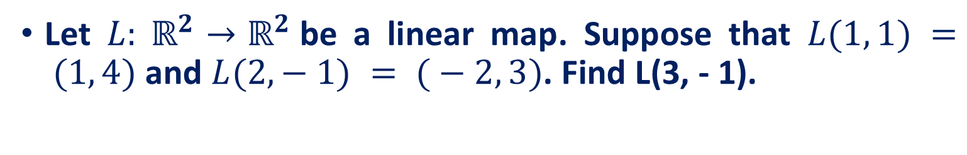
Linear Transformation
Let $L: ℝ^{2}→ℝ^{2}$be a linear map. Suppose that $L(1, 1) = (1, 4)$and $L(2, − 1) = ( − 2, 3)$. Find L(3, - 1).
We write (3, -1) as a linear combination of (1,1) and (2, -1). Thus, we have to solve
$$(3, −1) = x(1, 1) + y(2, −1)$$
This amounts to solving
$$x + 2y = 3,$$
$$x− y=−1$$
The solution is $x = \frac{1}{3}, y = \frac{4}{3}$. Hence
$$L(3, −1) = xL(1, 1) + yL(2, −1) = \frac{1}{3}(1,4) + \frac{4}{3} (−2,3) = (\frac{−7}{3}, \frac{16}{3}).$$

Slide 8
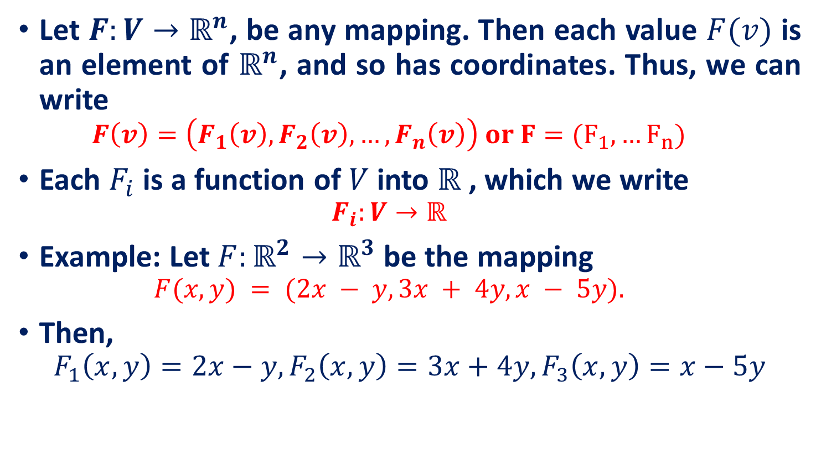
The coordinates of a linear map
Let $F:V→ℝ^{n}$, be any mapping. Then each value $F(v)$ is an element of $ℝ^{n}$, and so has coordinates. Thus, we can write
$$F\left(v\right)=\left(F_{1}\left(v\right), F_{2}\left(v\right),…, F_{n}\left(v\right)\right) or F=(F_{1},…F_{n})$$
Each $F_{i}$ is a function of $V$ into $ℝ$ , which we write
$$F_{i}:V→ℝ$$
Example: Let $F:ℝ^{2}→ℝ^{3}$be the mapping
$$F(x, y) = (2x − y, 3x + 4y, x − 5y).$$
Then,
$$F_{1}\left(x, y\right)=2x−y, F_{2}\left(x, y\right)=3x+4y, F_{3}\left(x, y\right)=x−5y$$

Slide 9
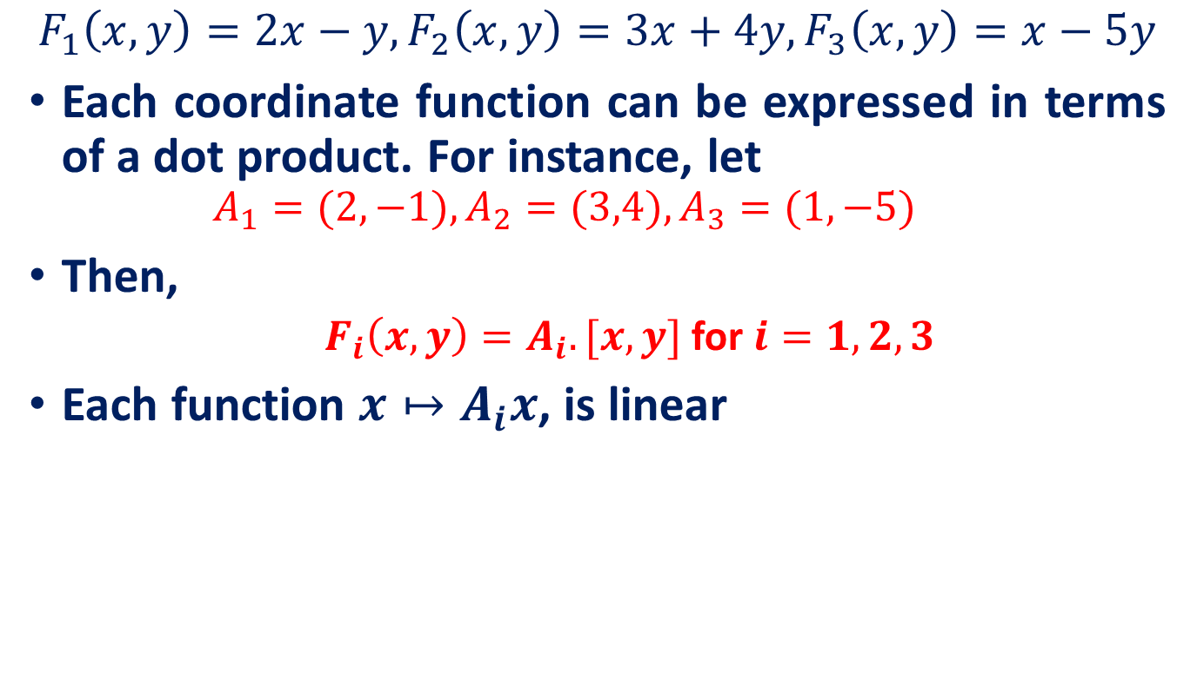
The coordinates of a linear map
$$F_{1}\left(x, y\right)=2x−y, F_{2}\left(x, y\right)=3x+4y, F_{3}\left(x, y\right)=x−5y$$
Each coordinate function can be expressed in terms of a dot product. For instance, let
$$A_{1}=(2, −1), A_{2}=(3,4), A_{3}=(1,−5)$$
Then,
$F_{i}\left(x,y\right)=A_{i}.[x,y]$ for $i=1,2,3$
Each function $x↦A_{i}x$, is linear

Slide 10
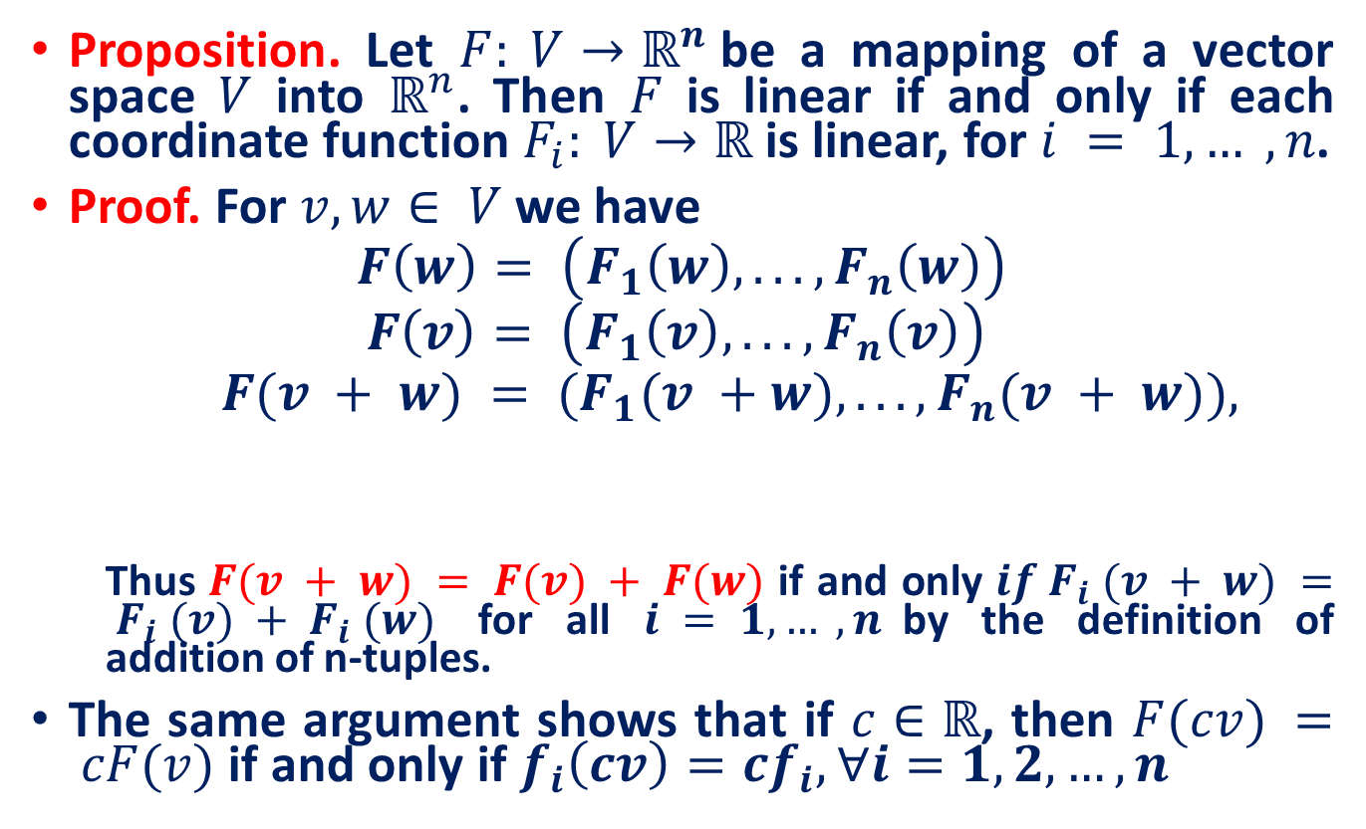
The coordinates of a linear map
Proposition. Let $F: V→ℝ^{n}$be a mapping of a vector space $V$ into $ℝ^{n}$. Then $F$ is linear if and only if each coordinate function $F_{i}: V→ℝ$ is linear, for $i = 1, … ,n$.
Proof. For $v, w∈ V$we have
$$F\left(w\right)= \left(F_{1}\left(w\right), ... ,F_{n}\left(w\right)\right)$$
$$F\left(v\right)= \left(F_{1}\left(v\right), ... ,F_{n}\left(v\right)\right)$$
$$F(v + w) = (F_{1}(v +w), ... ,F_{n}(v + w)),$$
Thus $F(v + w) = F(v) + F(w)$ if and only $if F_{i} (v + w) = F_{i} (v) + F_{i} (w)$ for all $i = 1, … ,n$by the definition of addition of n-tuples.
The same argument shows that if $c∈ℝ$, then $F(cv) = cF(v)$ if and only if $f_{i}\left(cv\right)=cf_{i}, ∀i=1,2,…,n$

Slide 11
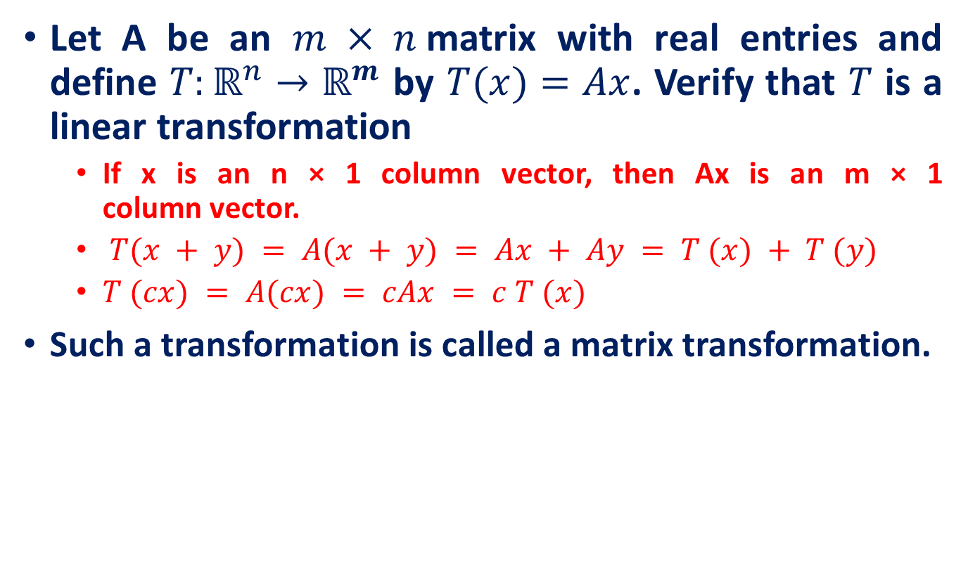
Linear transformations from $ℝ^{n}$ to $ℝ^{m}$
Let A be an $m × n$matrix with real entries and define $T:ℝ^{n}→ℝ^{m}$ by $T(x)=Ax$. Verify that $T$ is a linear transformation
If x is an n × 1 column vector, then Ax is an m × 1 column vector.
$T(x + y) = A(x + y) = Ax + Ay = T (x) + T (y)$
$T (cx) = A(cx) = cAx = c T (x)$
Such a transformation is called a matrix transformation.

Slide 12
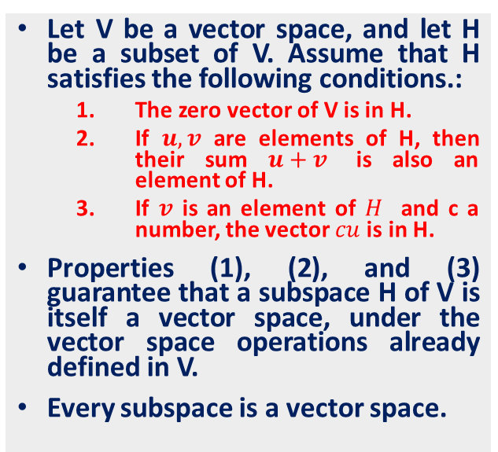
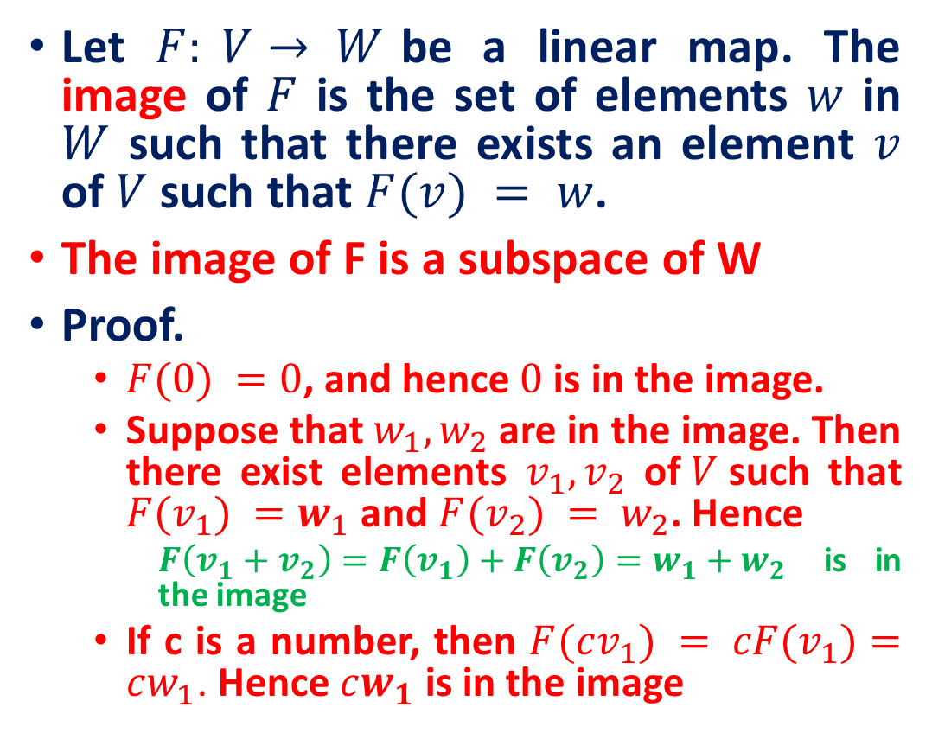
The Kernel and Image of a Linear Map
Let $F: V→ W$be a linear map. The image of $F$ is the set of elements $w$ in $W$ such that there exists an element $v$ of $V$ such that $F(v) = w$.
The image of F is a subspace of W
Proof.
$F(0) =0$, and hence $0$ is in the image.
Suppose that $w_{1}, w_{2}$are in the image. Then there exist elements $v_{1}, v_{2}$ of$V$such that $F(v_{1}) =w_{1}$ and $F(v_{2}) = w_{2}$. Hence
$F\left(v_{1}+v_{2}\right)=F\left(v_{1}\right)+F\left(v_{2}\right)=w_{1}+w_{2}$ is in the image
If c is a number, then $F(cv_{1}) = cF(v_{1})=cw_{1}$. Hence $cw_{1}$is in the image
Let V be a vector space, and let H be a subset of V. Assume that H satisfies the following conditions.:
The zero vector of V is in H.
If $u, v$ are elements of H, then their sum $u+v$ is also an element of H.
If $v$ is an element of $H$ and c a number, the vector $cu$ is in H.
Properties (1), (2), and (3) guarantee that a subspace H of V is itself a vector space, under the vector space operations already defined in V.
Every subspace is a vector space.

Slide 13
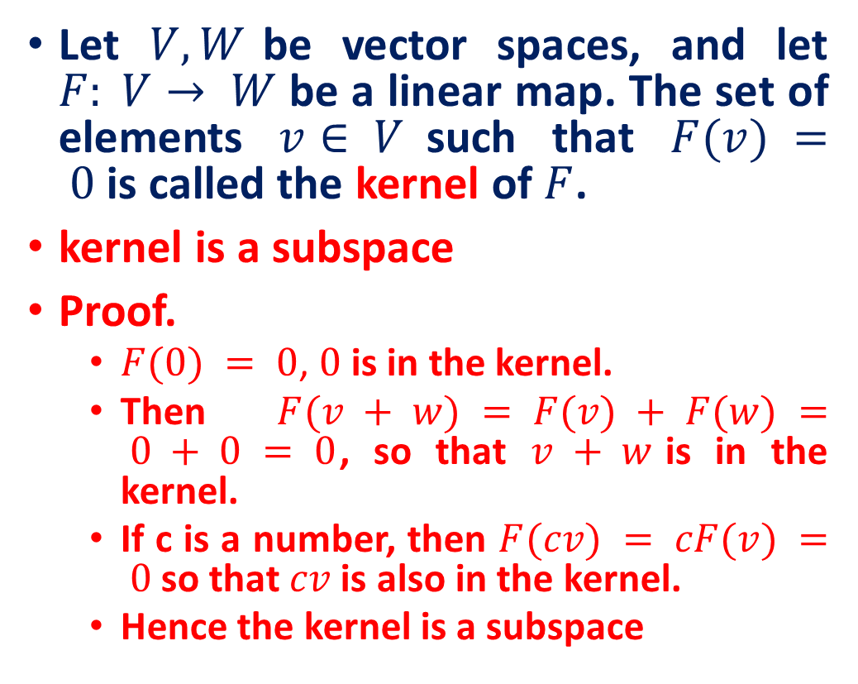
The Kernel and Image of a Linear Map
Let $V, W$be vector spaces, and let $F: V→ W$be a linear map. The set of elements $v∈ V$such that $F(v) = 0$is called the kernel of $F$.
kernel is a subspace
Proof.
$F(0) = 0$, $0$ is in the kernel.
Then $F(v + w) = F(v) + F(w) = 0 + 0 = 0$, so that $v + w$is in the kernel.
If c is a number, then $F(cv) = cF(v) = 0$so that $cv$ is also in the kernel.
Hence the kernel is a subspace
Let V be a vector space, and let H be a subset of V. Assume that H satisfies the following conditions.:
The zero vector of V is in H.
If $u, v$ are elements of H, then their sum $u+v$ is also an element of H.
If $v$ is an element of $H$ and c a number, the vector $cu$ is in H.
Properties (1), (2), and (3) guarantee that a subspace H of V is itself a vector space, under the vector space operations already defined in V.
Every subspace is a vector space.

Slide 14
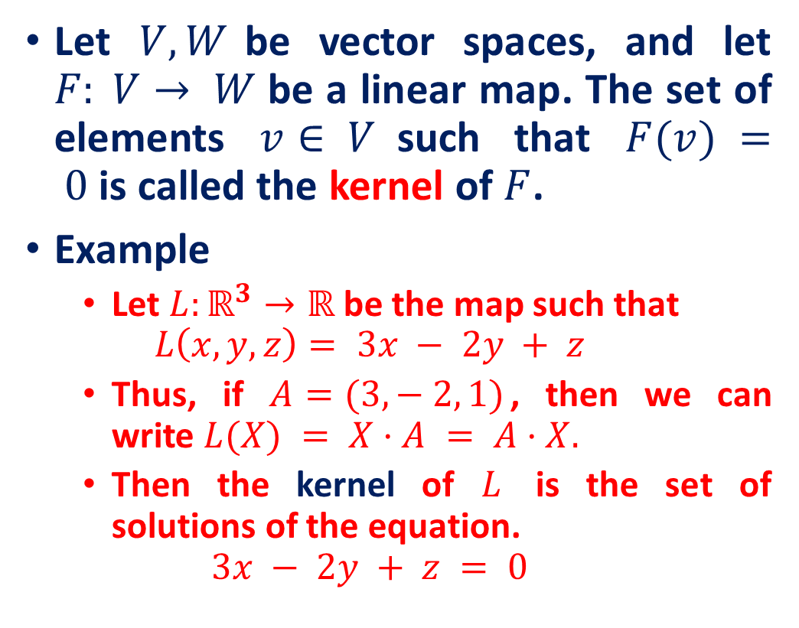
The Kernel and Image of a Linear Map
Let $V, W$be vector spaces, and let $F: V→ W$be a linear map. The set of elements $v∈ V$such that $F(v) = 0$is called the kernel of $F$.
Example
Let $L:ℝ^{3}→ℝ$ be the map such that
$$L\left(x, y, z\right)= 3x − 2y + z$$
Thus, if $A=(3, − 2, 1)$, then we can write $L(X) = X·A = A·X.$
Then the kernel of $L$ is the set of solutions of the equation.
$$3x − 2y + z = 0$$
Let V be a vector space, and let H be a subset of V. Assume that H satisfies the following conditions.:
The zero vector of V is in H.
If $u, v$ are elements of H, then their sum $u+v$ is also an element of H.
If $v$ is an element of $H$ and c a number, the vector $cu$ is in H.
Properties (1), (2), and (3) guarantee that a subspace H of V is itself a vector space, under the vector space operations already defined in V.
Every subspace is a vector space.

Slide 15
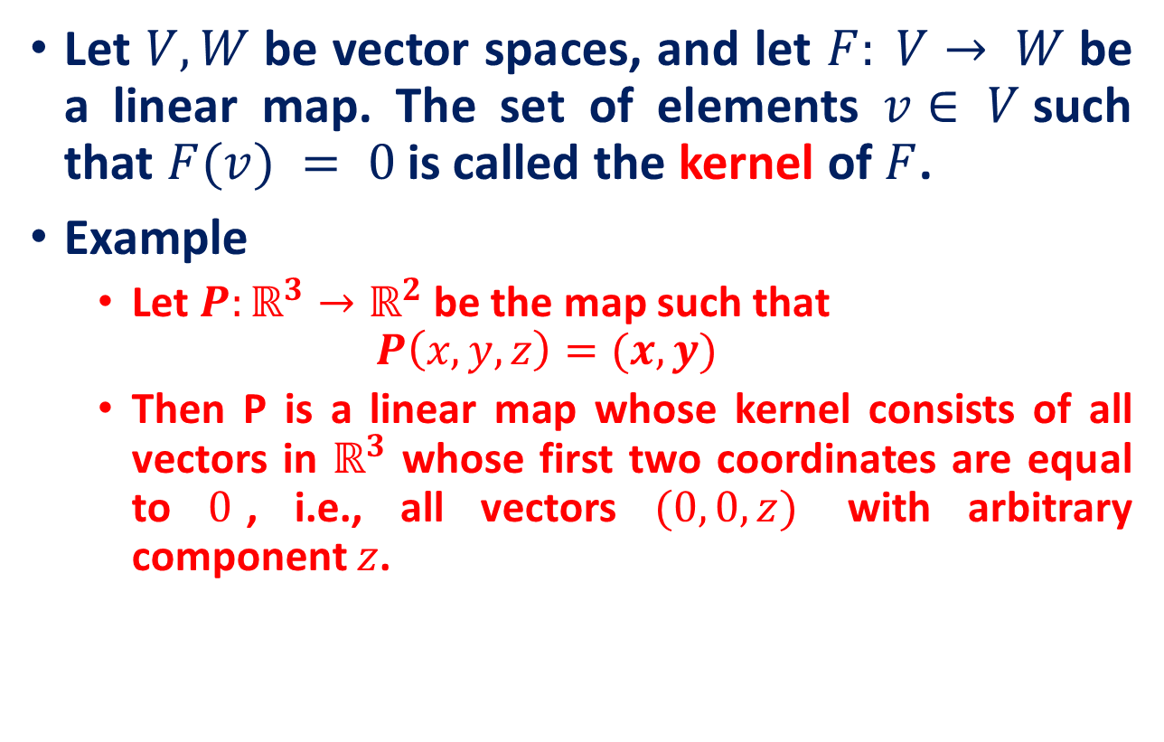
The Kernel and Image of a Linear Map
Let $V, W$be vector spaces, and let $F: V→ W$be a linear map. The set of elements $v∈ V$such that $F(v) = 0$is called the kernel of $F$.
Example
Let $P:ℝ^{3}→ℝ^{2}$ be the map such that
$$P\left(x, y, z\right)=(x,y)$$
Then P is a linear map whose kernel consists of all vectors in $ℝ^{3}$ whose first two coordinates are equal to $0$, i.e., all vectors $(0, 0, z)$ with arbitrary component $z$.

Slide 16
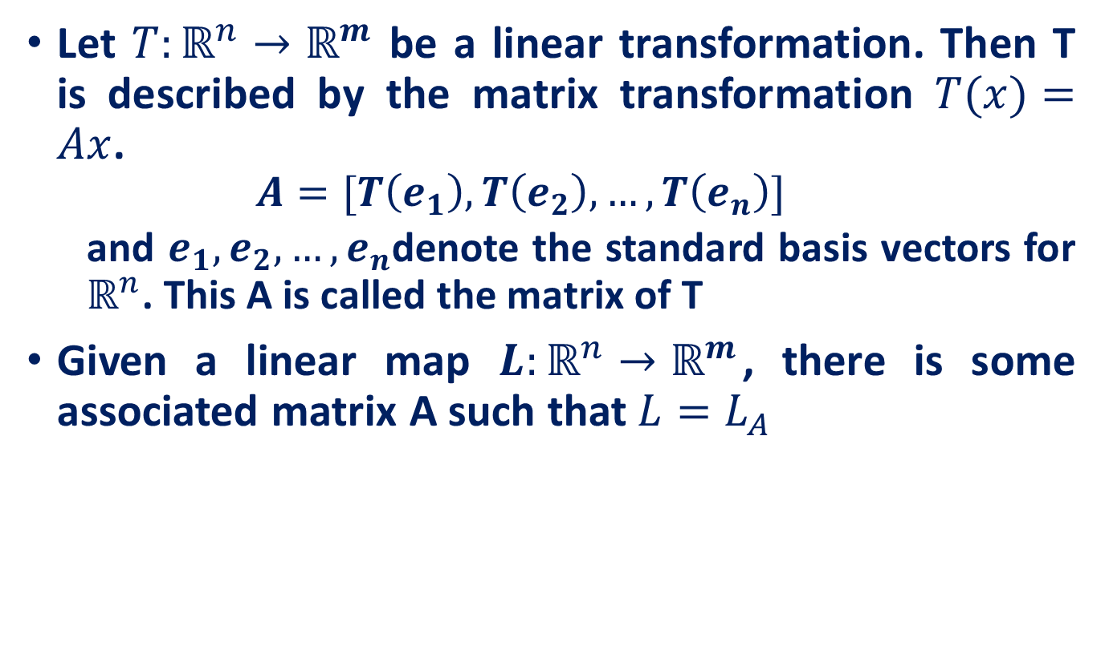
Matrix transformations
Let $T:ℝ^{n}→ℝ^{m}$ be a linear transformation. Then T is described by the matrix transformation $T(x)=Ax$.
$$A=[T\left(e_{1}\right), T\left(e_{2}\right),…, T\left(e_{n}\right)]$$
and $e_{1},e_{2}, …, e_{n}$denote the standard basis vectors for $ℝ^{n}$. This A is called the matrix of T
Given a linear map $L:ℝ^{n}→ℝ^{m}$, there is some associated matrix A such that$L=L_{A}$

Slide 17
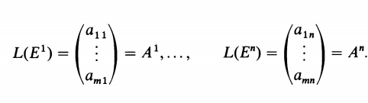
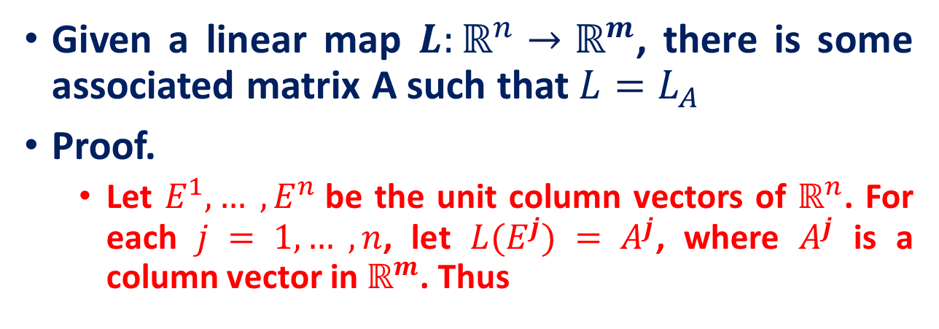

The Matrix Associated with a Linear Map
Given a linear map $L:ℝ^{n}→ℝ^{m}$, there is some associated matrix A such that$L=L_{A}$
Proof.
Let $E^{1}, … ,E^{n}$be the unit column vectors of $ℝ^{n}$. For each $j = 1, … ,n$, let $L(E^{j}) = A^{j}$, where $A^{j}$ is a column vector in $ℝ^{m}$. Thus
Then for every element $x$ in $ℝ^{n}$, we can write
$$x=x_{1}E^{1}+x_{2}E^{2}+…+x_{n}E^{n}=\left[\begin{matrix}x_{1} \\ \begin{aligned}⋮ \\ x_{n}\end{aligned}\end{matrix}\right]$$

Slide 18
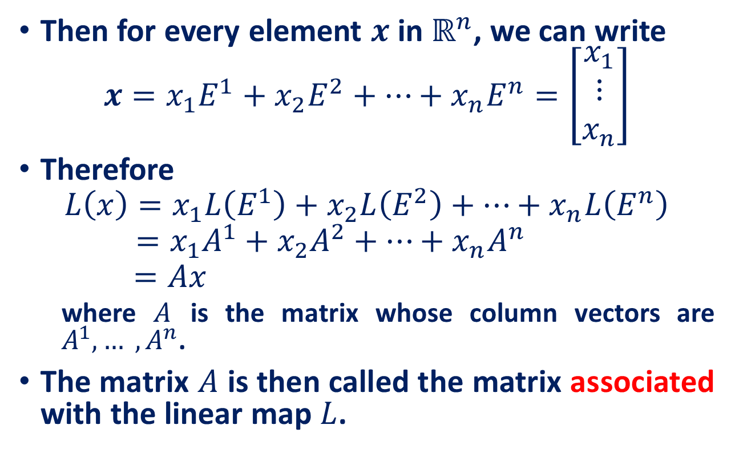
The Matrix Associated with a Linear Map
Then for every element $x$ in $ℝ^{n}$, we can write
$$x=x_{1}E^{1}+x_{2}E^{2}+…+x_{n}E^{n}=\left[\begin{matrix}x_{1} \\ \begin{aligned}⋮ \\ x_{n}\end{aligned}\end{matrix}\right]$$
Therefore
$$L\left(x\right)=x_{1}L\left(E^{1}\right)+x_{2}L\left(E^{2}\right)+…+x_{n}L\left(E^{n}\right)$$
$$=x_{1}A^{1}+x_{2}A^{2}+…+x_{n}A^{n}$$
$$=Ax$$
where $A$ is the matrix whose column vectors are $A^{1}, … ,A^{n}$.
The matrix $A$ is then called the matrix associated with the linear map $L$.

Slide 19
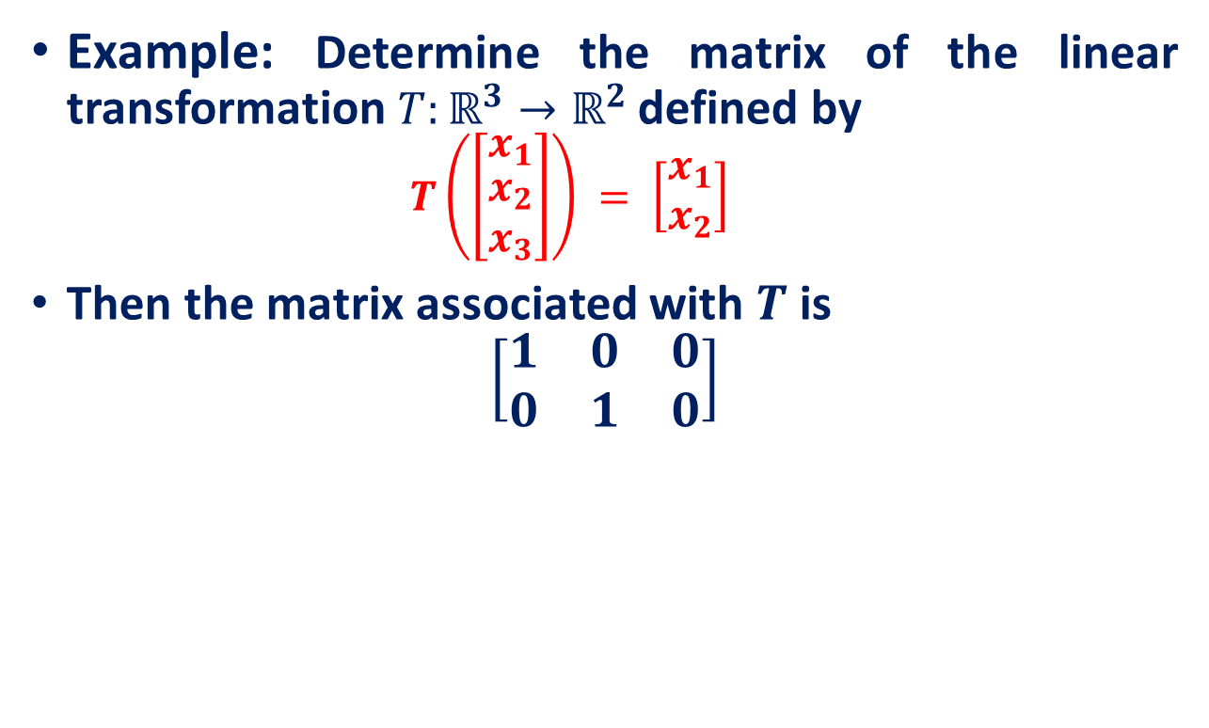
The Matrix Associated with a Linear Map
Example: Determine the matrix of the linear transformation $T:ℝ^{3}→ℝ^{2}$ defined by
$$T\left(\left[\begin{matrix}x_{1} \\ \begin{aligned}x_{2} \\ x_{3}\end{aligned}\end{matrix}\right]\right) = \left[\begin{matrix}x_{1} \\ x_{2}\end{matrix}\right]$$
Then the matrix associated with $T$ is
$$\left[\begin{matrix}1 & 0 & 0 \\ 0 & 1 & 0\end{matrix}\right]$$

Slide 20
Reference
Introduction to Linear Algebra, Serge Lang, Second Edition
Linear Transformations, Math 240 , Calculus III, Summer 2013, Session II

